Slide 1
LESSON 12

Slide 2
Overview
of
Previous Lesson(s)

Slide 3
Over View
A regular expression is a sequence of characters that forms a search pattern, mainly for use in pattern matching with strings.
The idea is that the regular expressions over an alphabet consist of the alphabet, and expressions using union, concatenation, and *.
Each regular expression r denotes a language L(r) , which is also defined recursively from the languages denoted by r's sub-expressions.

Slide 4
Over View..
As an intermediate step in lexical analysis, we convert patterns into flowcharts, called transition diagrams.
Transition diagrams have a collection of nodes or circles, called states
Each state represents a condition that could occur during the process of scanning the input looking for a lexeme that matches one of several patterns.
Edges are directed from one state of the transition diagram to another.
Each edge is labeled by a symbol or set of symbols.

Slide 5
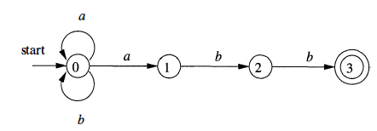
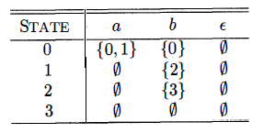
Over View…
Transition graph for an NFA recognizing the language of regular expression (a | b) * abb
Transition Table for (a | b) * abb

Slide 6
Over View…
An NFA accepts a string if the symbols of the string specify a path from the start to an accepting state.
These symbols may specify several paths, some of which lead to accepting states and some that don't.
In such a case the NFA does accept the string, one successful path is enough.
If an edge is labeled ε, then it can be taken for free.

Slide 7
Over View…
A deterministic finite automaton (DFA) is a special case of an NFA where:
There are no moves on input ε, and
For each state S and input symbol a, there is exactly one edge out of s labeled a.

Slide 8
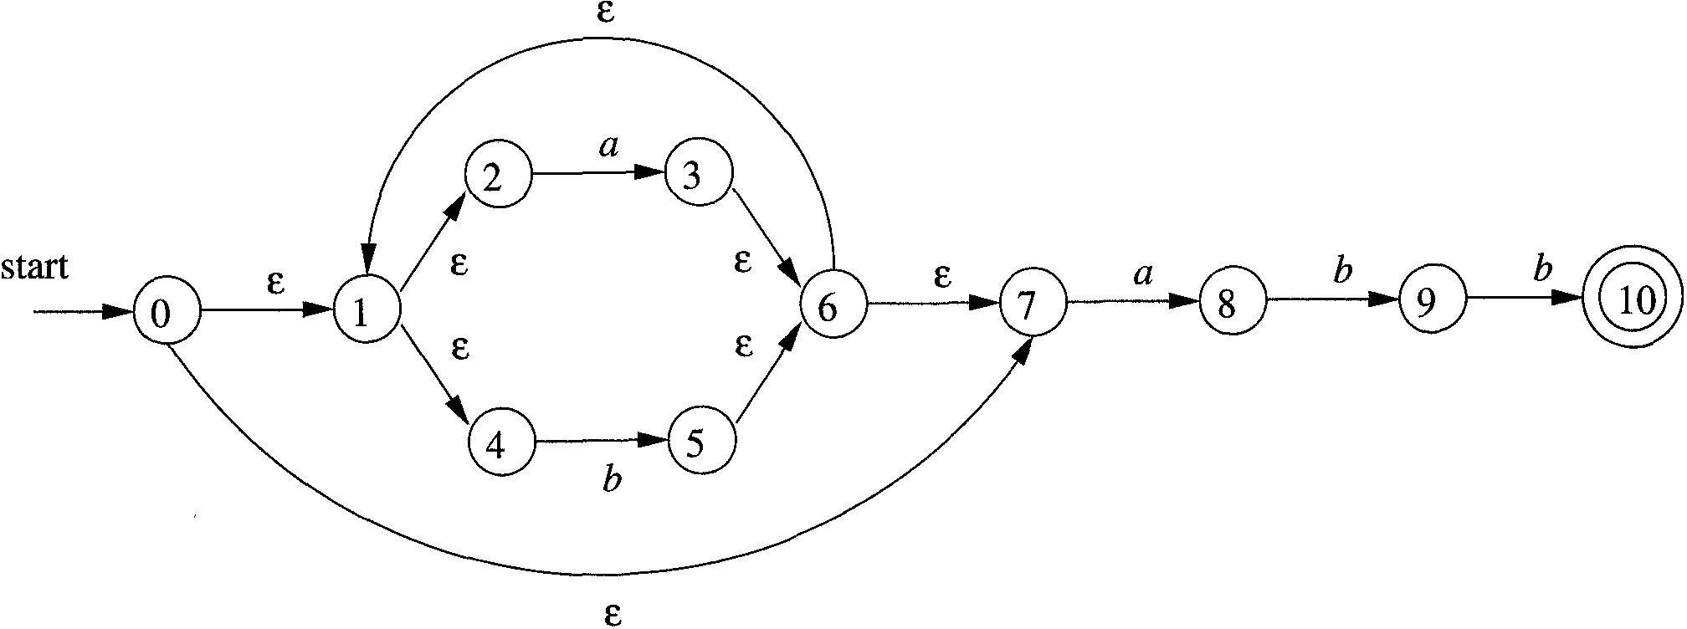
Over View…
NFA to DFA
A NFA that accepts strings satisfying the regular expression (a|b)*abb over alphabet {a,b}

Slide 9
Over View…
The start state of D is the set of N-states that can result when N processes the empty string ε.
This is called the ε-closure of the start state s₀ of N, and consists of those N-states that can be reached from s₀ by following edges labeled with ε.
ɛ-closure(0) = D₀ = {0,1,2,4,7}
We call this state D₀ and enter it in the transition table
b | a | DFA States | NFA States
 |  | D₀ | {0,1,2,4,7}

Slide 10
Over View…
Next we want the a-successor of D₀, i.e., the D-state that occurs when we start at D₀ and move along an edge labeled a.
We call this successor D₁.
Since D₀ consists of the N-states corresponding to ε, D₁ is the N-states corresponding to εa=a.
We compute the a-successor of all the N-states in D₀ and then form the ε-closure.
ɛ-closure(move(A,a) = D₁ = {1,2,3,4,6,7,8}

Slide 11
Over View…
We continue forming a- and b-successors of all the D-states until no new D-states result.
So the final transition table is
b | a | DFA States | NFA States
D₂ | D₁ | D₀ | {0,1,2,4,7}
D₃ | D₁ | D₁ | {1,2,3,4,6,7,8}
D₂ | D₁ | D₂ | {1,2,4,5,6,7}
D₄ | D₁ | D₃ | {1,2,4,5,6,7,9}
D₂ | D₁ | D₄ | {1,2,4,5,6,7,10}

Slide 12
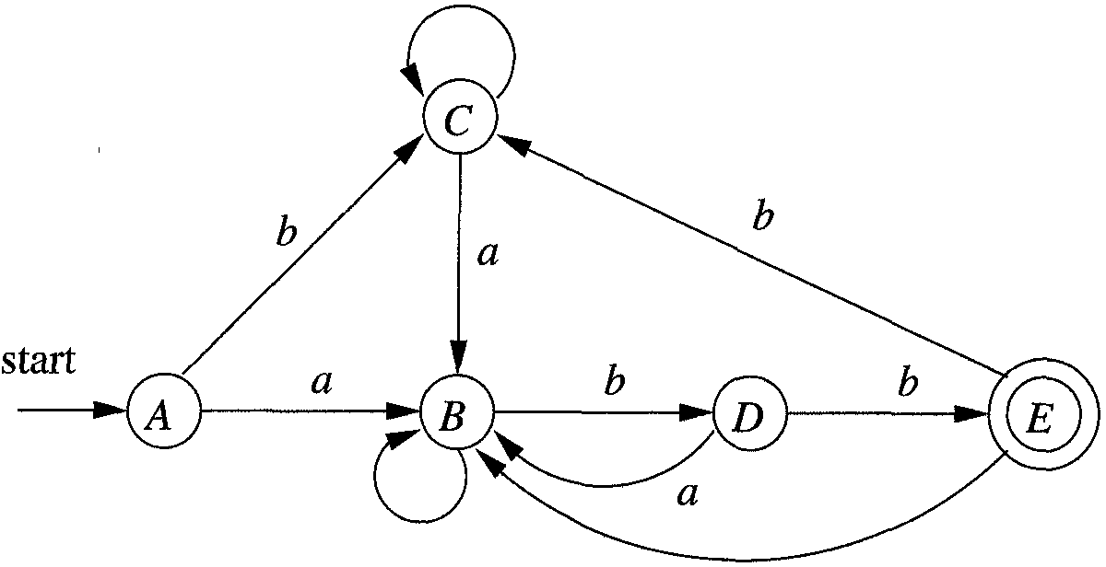
Over View…
So after applying this result on the NFA we got

Slide 13
TODAY’S LESSON

Slide 14
Contents
Simulation of an NFA
Construction of RE to NFA

Slide 15


Simulation of an NFA
A strategy that has been used in a number of text-editing programs is to construct an NFA from a regular expression and then simulate the NFA.

Slide 16
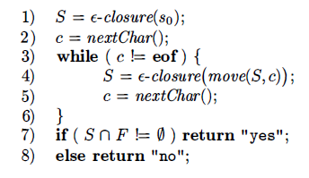
Simulation of an NFA..
Algorithm:

Slide 17

Construction of RE to NFA
Now we see an algorithm for converting any RE to NFA .
The algorithm is syntax- directed, it works recursively up the parse tree for the regular expression.
For each subexpression the algorithm constructs an NFA with a single accepting state.

Slide 18
Construction of RE to NFA..
Method:
Begin by parsing r into its constituent subexpressions.
The rules for constructing an NFA consist of basis rules for handling subexpressions with no operators.
Inductive rules for constructing larger NFA's from the NFA's for the immediate sub expressions of a given expression.

Slide 19

Construction of RE to NFA...
Basis Step:
For expression ɛ construct the NFA
Here, i is a new state, the start state of this NFA, and f is another new state, the accepting state for the NFA.

Slide 20

Construction of RE to NFA...
Now for any sub-expression a in Σ construct the NFA
Here again , i is a new state, the start state of this NFA, and f is another new state, the accepting state for the NFA.
In both of the basis constructions, we construct a distinct NFA, with new states, for every occurrence of ε or some a as a sub expression of r.

Slide 21
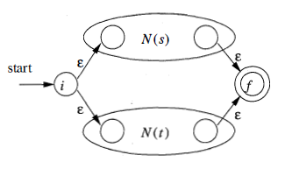
Construction of RE to NFA...
Induction Step:
Suppose N(s) and N(t) are NFA's for regular expressions s and t, respectively.
If r = s|t. Then N(r) , the NFA for r, should be constructed as
N(r) accepts L(s) U L(t) , which is the same as L(r) .

Slide 22

Construction of RE to NFA...
Now Suppose r = st , Then N(r) , the NFA for r, should be constructed as
N(r) accepts L(s)L(t) , which is the same as L(r) .

Slide 23
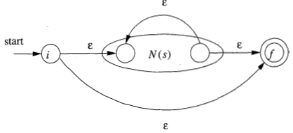
Construction of RE to NFA...
Now Suppose r = s* , Then N(r) , the NFA for r, should be constructed as
N(r) accept all the strings in L(s)¹ , L(s)² , and so on , so the entire set of strings accepted by N(r) is L(s*).

Slide 24
Construction of RE to NFA...
Finally suppose r = (s) , Then L(r) = L(s) and we can use the NFA N(s) as N(r).
Interesting properties
The generated NFA has at most twice as many states as there are operators and operands in the RE.
This bound follows from the fact that each step of the algorithm creates at most two new states.
The generated NFA has one start and one accepting state. The accepting state has no outgoing arcs and the start state has no incoming arcs.

Slide 25
Construction of RE to NFA...
Interesting properties..
The diagram for st correctly indicates that the final state of s and the initial state of t are merged. This is one use of the previous remark that there is only one start state and one final state.
Except for the accepting state, each state of the generated NFA has either one outgoing arc labeled with a symbol or two outgoing arcs labeled with ε.

Slide 26
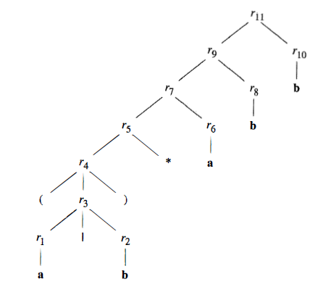
Construction of RE to NFA...
Ex. Construct an NFA for r (a|b)*abb
Parse tree for (a|b)* abb

Slide 27


Construction of RE to NFA...
For sub expression r₁ , the first a, we construct the NFA
Now for sub expression r₂ , we construct

Slide 28
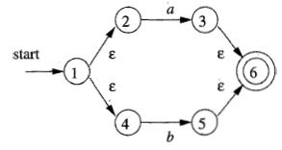
Construction of RE to NFA...
We can now combine N(r₁) and N(r₂), using the construction method discuss in 1st step of Induction to obtain the NFA for r₃ = r₁ | r₂
The NFA for r₄ = (r₃) is the same as that for r₃

Slide 29
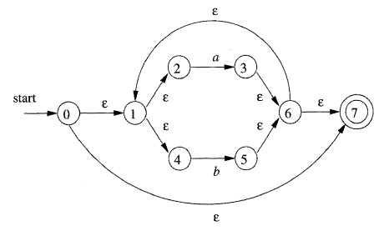
Construction of RE to NFA...
The NFA for r₅ = (r₃)*

Slide 30

Construction of RE to NFA...
Now consider expression r₆ which is another a.
We can use the basis construction for a again, but we must use new states.
NFA for r₆ is

Slide 31
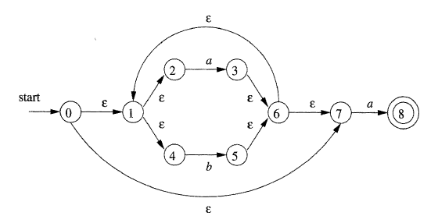
Construction of RE to NFA...
We can obtain the NFA for r₇ as r₇ = r₅ r₆

Slide 32
Construction of RE to NFA...
Continuing in this fashion with new NFA's for the two sub expressions b called r₈ and r₁₀ , we eventually construct the NFA for (a|b) * abb

Slide 33
Thank You

